Slide 1
The Symmetry Podcast Website
Ben LeBoutillier

Slide 2

Background
Developer
Bachelor’s in Physics, University of Florida class of 2017
Emergency Room Technician, 4 years
Podium endurance runner
Lived in Nevis, West Indies for 6 months
Capstone
Based upon real podcast
Hoping for future recrudescence and implementation

Slide 3
Technologies Used
Front End
HTML
CSS
JavaScript
With jQuery
AJAX
With JSON
Bootstrap
Back End
Java
Spring
Tomcat
Java Persistence API
Java Mail API
Lombok
Database
MySQL
MySQL Workbench
IDE, Text Editor
NetBeans
Visual Studio Code
Notepad++

Slide 4
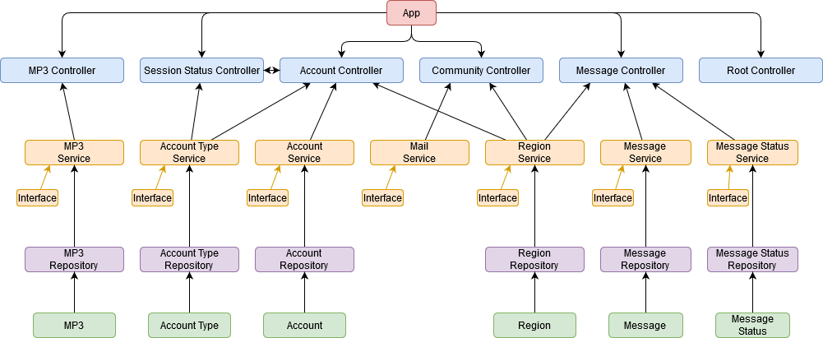
Back End

Slide 5
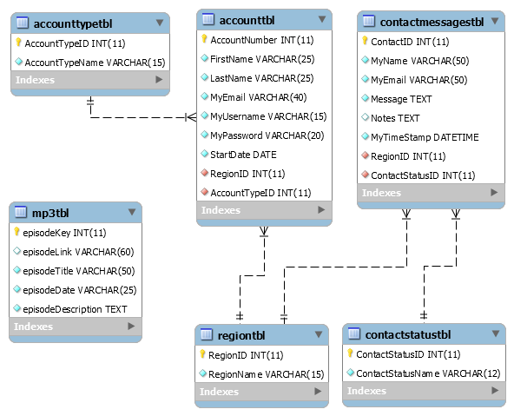
Database

Slide 6
Reflection
Challenges
Formatting homepage
Solution: flex-boxes
PHP
Solution: JavaScript
Asynchronous calls
Solution: refactorization, timeouts
Large file(s)
File uploader
Future Enhancements
File Uploader
Internal search engine
Listen page: tabs for each season
Audit log of episodes played
Ability to host live broadcasts
Stronger security

Slide 7
The Symmetry Podcast Website

